Slide 1
Preserving voices: Exploring Endangered Languages and the Threat of Language Extinction
Abhishek Ladwa

Slide 2
What is language death?
“Language death refers to the phenomenon where a language no longer has any speakers or active users”
Notes:
Language death refers to the phenomenon where a language no longer has any speakers or active users, leading to its extinction as a living means of active communication.
There are several factors that contribute to this phenomenon occurring, which will be further looked into in this presentation.
Language death is a significant concern within the field of linguistics, as it not only means the loss of a spoken language, but also represents the loss of culture, human heritage, and diversity.
This study aims to find insights, explore reasons and draw conclusions about why languages are dying out, and what could be done to preserve them.

Slide 3
Goals
Explore and find insights within the data
Use these to find more specific insights and draw conclusions from this
Two different data sets were used for this: one of non-endangered languages, and one of endangered languages
Notes:
After exploring both data sets to find general insights into the trends, patterns and links of data involved, the aim was to then use this to dig deeper and find more specific insights that would aid in drawing useful and significant conclusions in several potential areas of this field.
This study looked into two different sets of data: one set which contained non-endangered languages, and another which contained a vast variety of endangered languages, all at varying classified levels of endangerment.

Slide 4
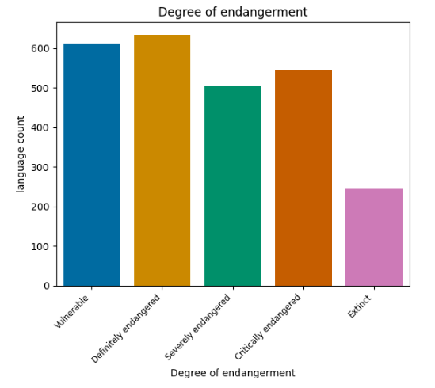
An endangered language - are they all in as much trouble as each other?
5 Levels of endangerment:
Vulnerable
Definitely Endangered
Severely Endangered
Critically Endangered
Extinct

Slide 5
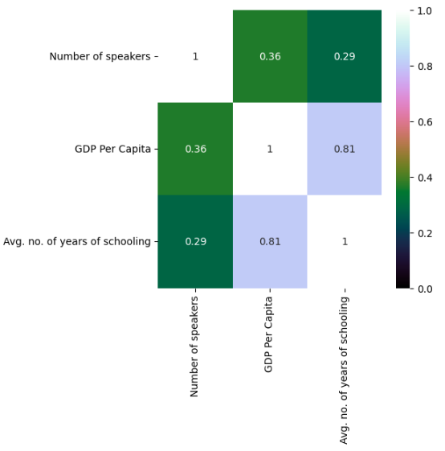
Do the GDP per capita and the number of years of schooling affect the number of speakers of a language?
Notes:
The correlation shows that the GDP per capita and number of years of schooling within a country may not as strongly affect the number of speakers of a particular language.
However, there is still a weak correlation present, which suggests that these factors could affect the number of speakers of a language in these countries, as well as other factors which may more strongly correlate.

Slide 6
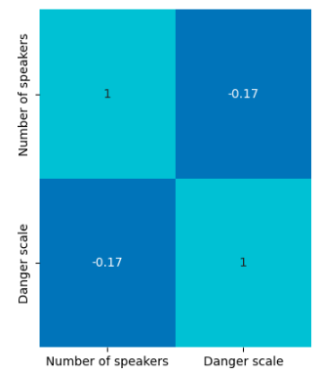
Is there a correlation between the number of speakers of an endangered language, and their endangered classification status?
Notes:
There is little to no correlation - the endangerment status of a language would be more directly correlated to other factors, such as official status, and influence/power that a linguistic group has.

Slide 7
The English Language: The greatest killer?
After looking into some general insights, the next step was focus on a more singular cause of language death - Assimilation to English.
The next section is a conducted study on the condition of endangered languages within the 5 majority native English speaking countries
Language | Avg. Number of speakers per language | Number of endangered languages spoken | Danger scale
United Kingdom | 330,393 | 9 | 2.86
New Zealand | 70,000 | 1 | 1.00
Canada | 2,326 | 71 | 2.35
United States of America | 1,659 | 215 | 3.60
Australia | 239 | 108 | 3.06

Slide 8
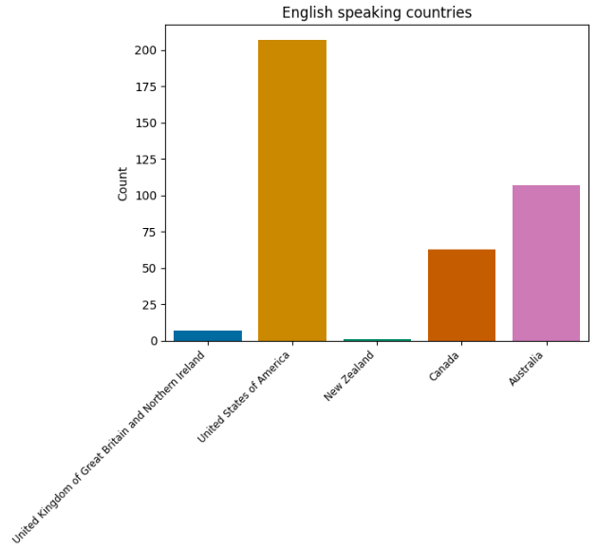
Highlighting where exactly the problem lies:

Slide 9
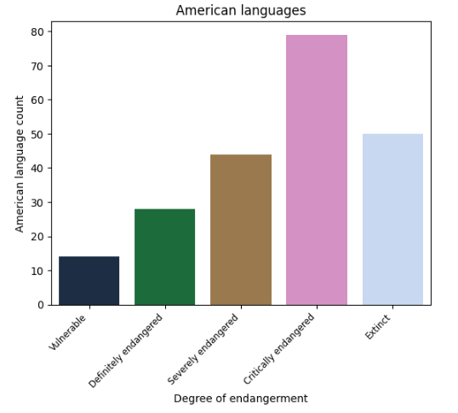
The Dominance of English in the USA:
Notes:
The endangerment status of the plurality of the languages in the US being critically endangered highly suggests that it relates to the genocide and diseases such as small-pox, which caused the death of many indigenous languages in the USA.

Slide 10
A further insight into the Critically endangered countries:
Countries | Number of Critically Endangered languages
USA | 78
Brazil | 43
Australia | 41
India | 37
China | 22
Mexico | 21
Russia | 19

Slide 11
Conclusions
Factors that affect language endangerment and the number of speakers include: GDP Per Capita, number of years of schooling, and language assimilation, all at varying levels.
A language with a larger number of speakers does not make them less endangered than other languages with less speakers.
Nations with less vulnerable languages have a better chance of preserving and stopping their languages dying if action is taken.

Slide 12
How can language death be stopped?
Identifying time-frames of what can realistically be saved, and acting promptly.
Financial motivation - nations must provide finances towards education of less spoken languages to help with preservation.
Status - granting more official status in areas where the language is spoken allows its speakers to be able to use their languages on a more practical scale, instead of using a more major lingua franca.

Slide 13
Thank you for listening
Please feel free to ask any questions you may have

